Slide 1
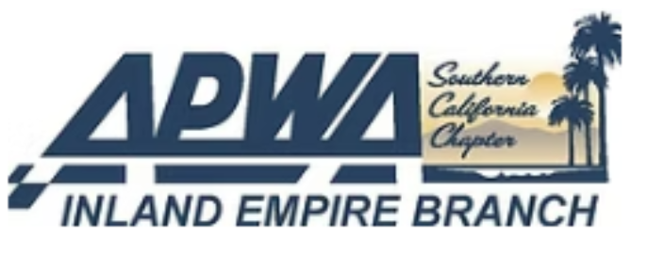

Water Quality
Management Plan
(WQMP)
March 6, 2025
Benjie Cho, P.E., QSD, TOR

Slide 2
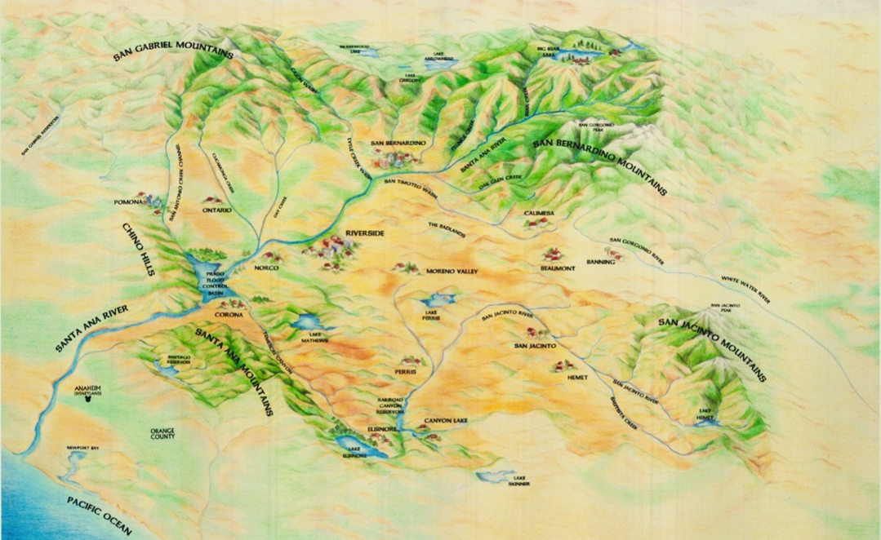


Why do we choose to be engineers?

Slide 3
overview
NPDES Background
Preliminary WQMPs (P-WQMP)
Final WQMPs (F-WQMP)
MS4 Permit Negotiations

Slide 4
NPDES Background

Slide 5
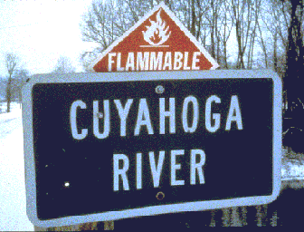
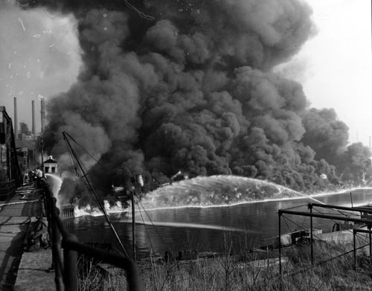
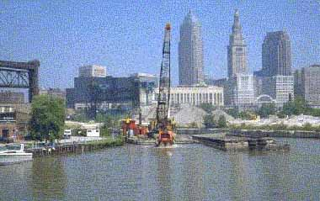
NPDES Background
Cuyahoga River, OH
November 4, 1952

Slide 6

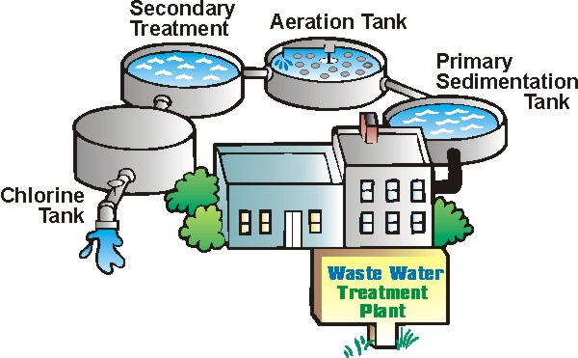
NPDES Background
The Clean Water Act (1972)
Enacted the Federal NPDES Program
Point sources
www.epa.gov
http://www.dep.state.pa.us/earthdaycentral/01/b4wastwat.htm

Slide 7
NPDES Background
California Porter Cologne Act (1969)
Requirements for Waste Dischargers
MS4 Permits are for both
Federal
State

Slide 8
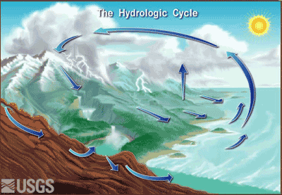
NPDES Background
The Clean Water Act Amendments (1987)
  Expanded to include storm water
Non-Point sources
Surface flow, streets, and MS4’s.
130.11.63.183/water.html

Slide 9
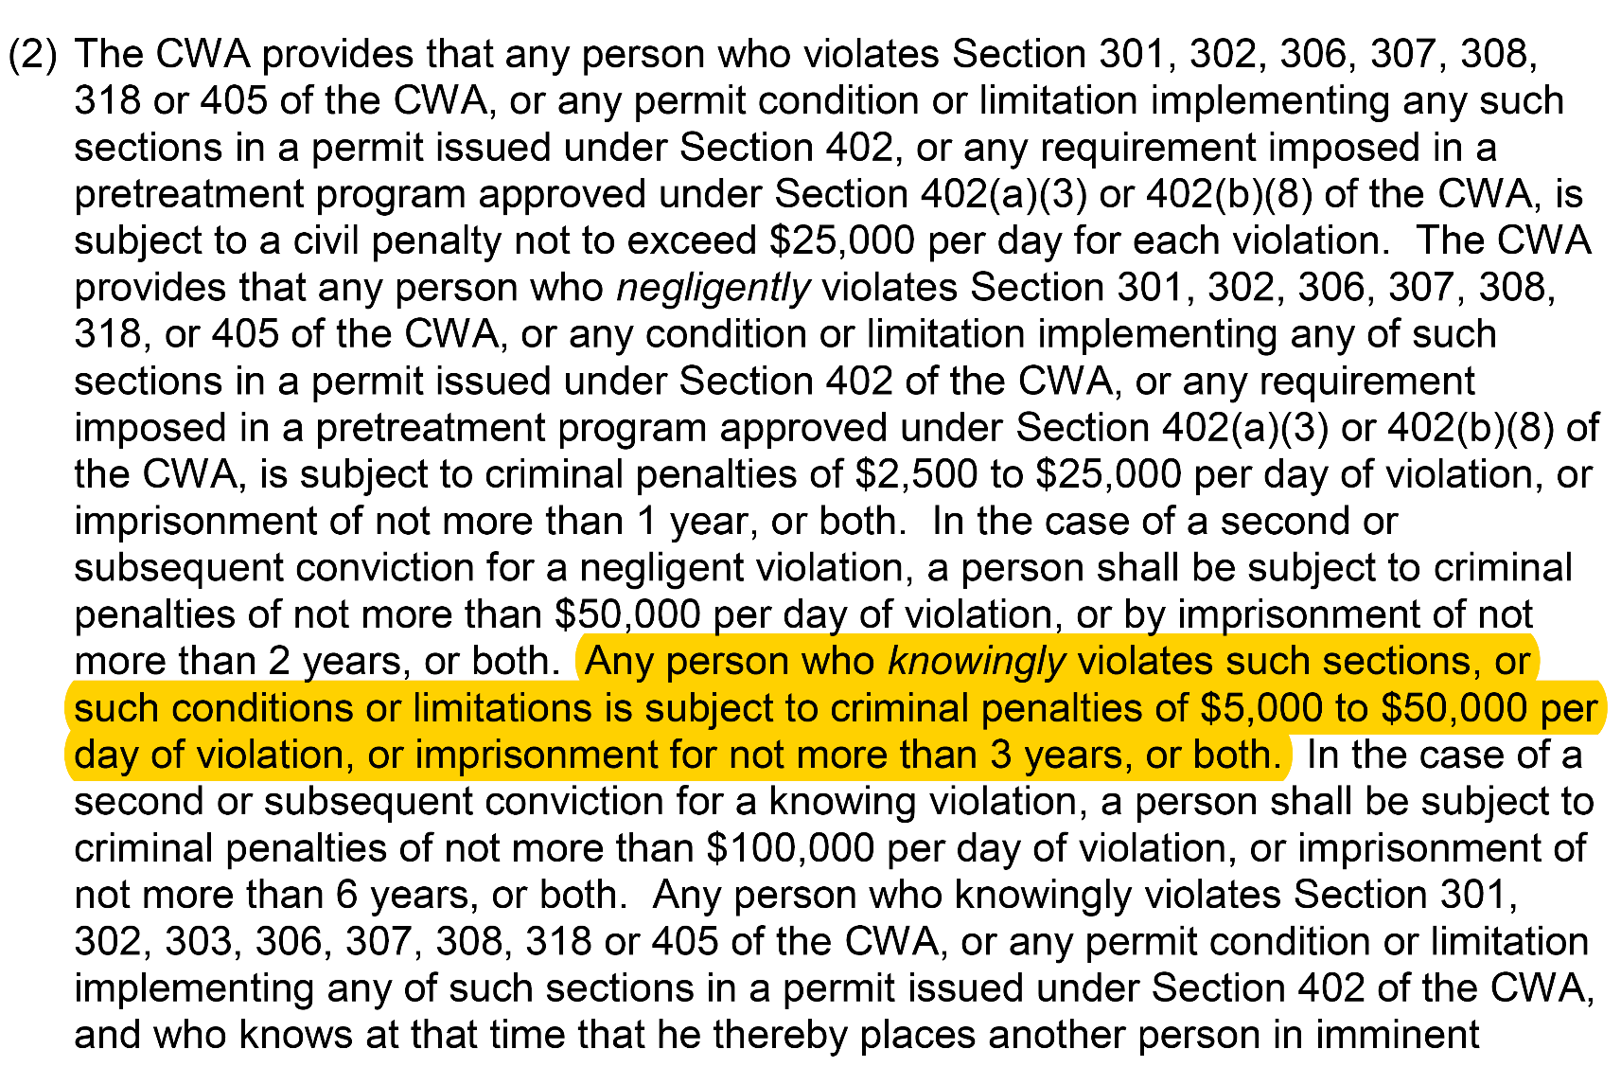
NPDES Background

Slide 10
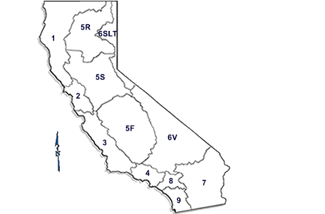
NPDES Background
Regional Boards
North Coast
San Francisco Bay
Central Coast
Los Angeles
Central Valley
Lahontan
Colorado River
Santa Ana
San Diego

Slide 11
NPDES Background
State Water Quality Control Board
Develop Statewide permits (e.g. Construction Permit, Trash Policy)
Make decisions on policies that apply statewide
Provides guidance to Regional Boards
Regional Water Quality Control Board
Assign Beneficial uses to water bodies in their watershed
  REC1 – contact with water (swimming, etc.)
  REC2 – Non contact with water (hiking, etc.)
Water Quality standards that support Beneficial Uses
Ensure compliance with Permits
  Municipalities with MS4 permits
  State permitted activities (Construction, Industrial, etc.)
Project Water Quality Certification (401 certification)

Slide 12
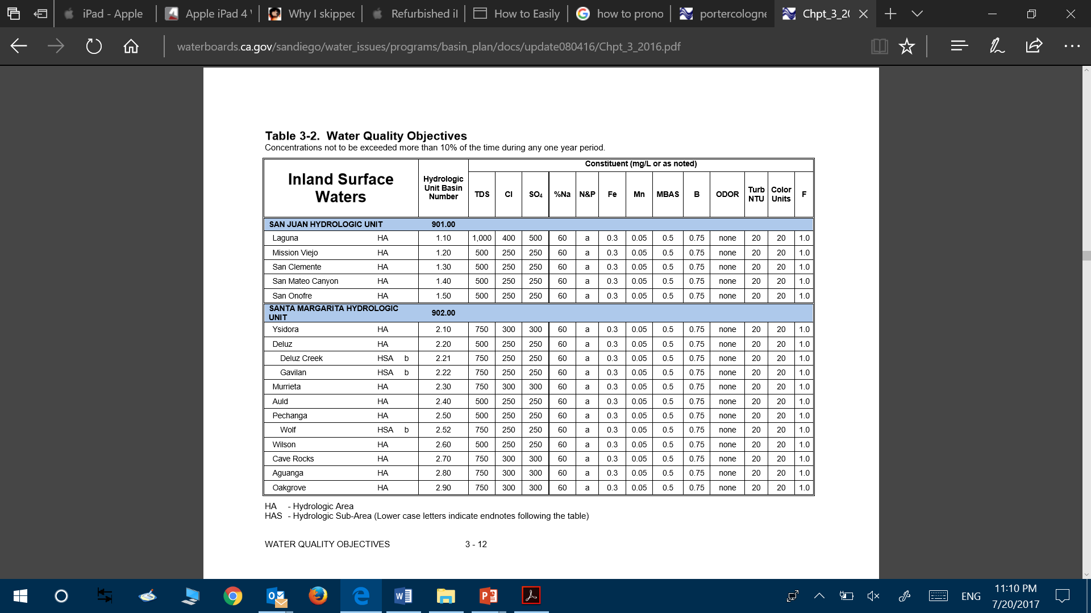
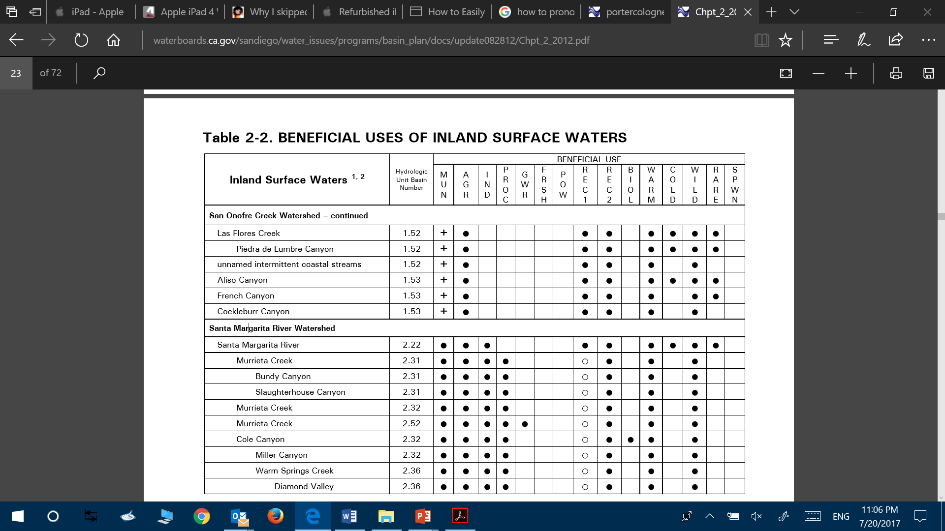
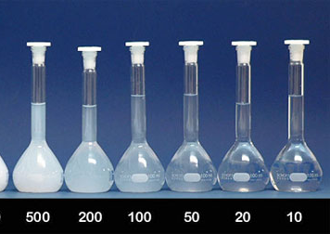
NPDES Background

Slide 13
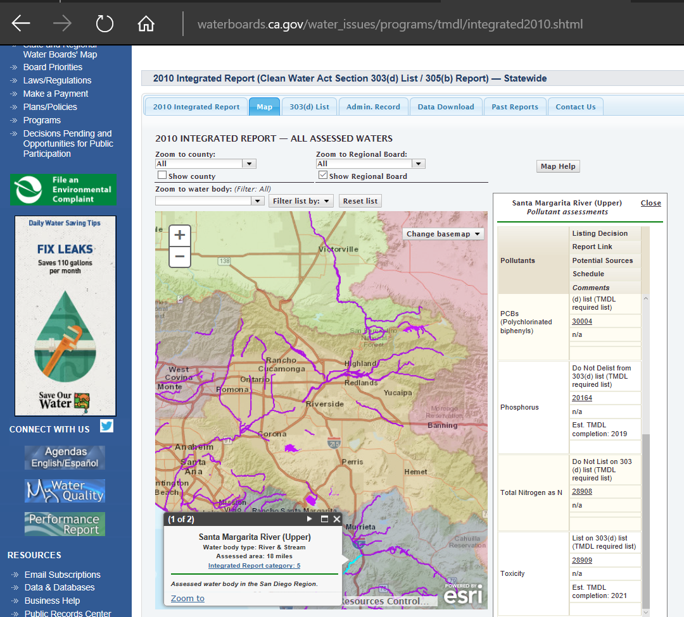
NPDES Background
(Potential) 303(d) Impairments
Verified thru TMDL (Total Daily Max Load) process
TMDLs (& Waste Load Allocations) are then written into MS4 Permits

Slide 14
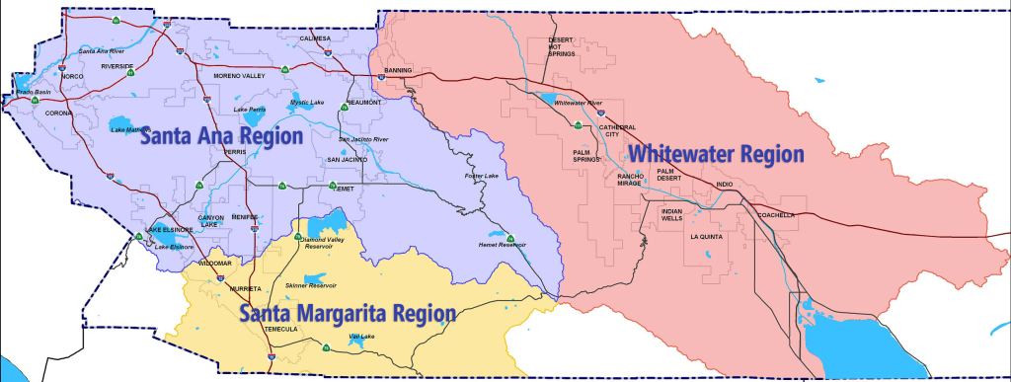
NPDES Background
3 Regional Boards in Riverside County
Permits update on roughly a 5 year cycle
To Arizona

Slide 15
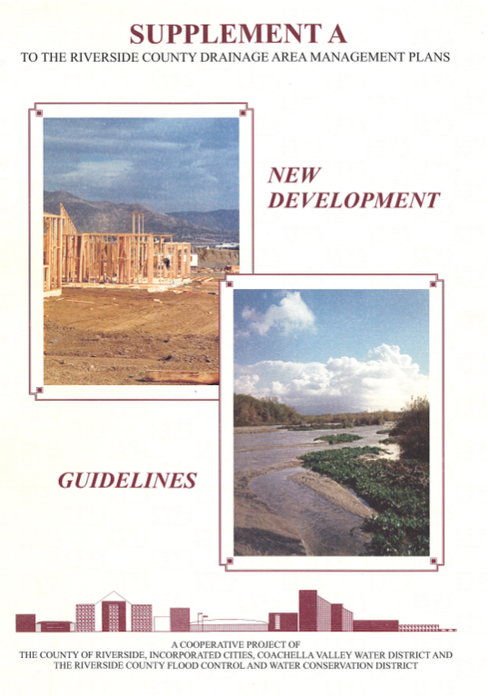

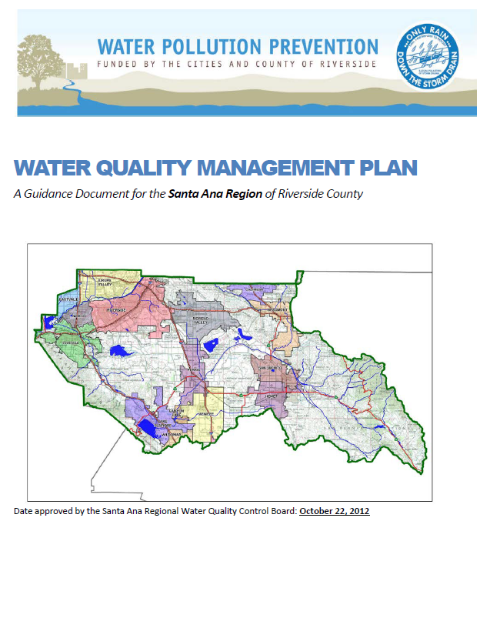
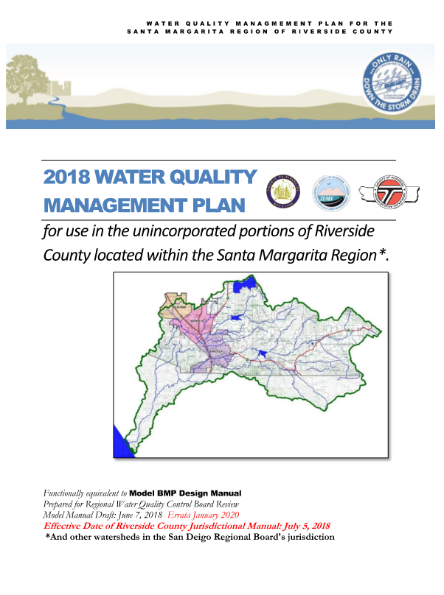

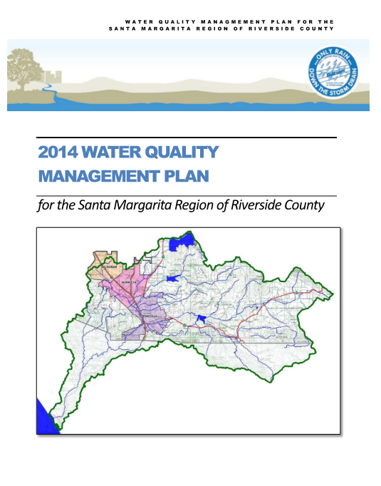
WQMP EVOLUTION
Santa Ana
San Diego
Whitewater
Prior to 2002 Permit
Drain to Pervious
No clear metrics
Projects submitted after January 1, 2005
BMPs of High or Medium Effectiveness for Pollutants of Concern
Projects entitled after December 6, 2012
LID BMPs only
BioRetention

Slide 16
APPLICABLE WQMPs
Upcoming
Santa Ana
2005-2012
12/6/2012+
San Diego
Check with your Co-Permittee. They may have stricter Grandfathering Rules.
Superseded 7/8/18
Whitewater
1/1/2015

Slide 17
Preliminary WQMPs

Slide 18
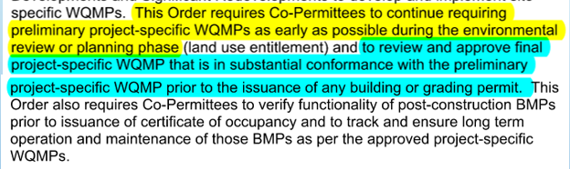
Preliminary WQMPs
Why is a Preliminary WQMP required?
The Permit requires:
Preliminary WQMPs for Entitlement
Final WQMP in substantial conformance with the P-WQMP.
Functionality of post-construction BMPs
Track and ensure long term O&M of those BMPs

Slide 19
Preliminary WQMPs
The Purpose of a P-WQMP is to determine FEASIBILITY and secure the SCOPE of the WQMP.
The 3 key factors:
WQMP Applicability
BMP Type (Required Hierarchy)
BMP sizing

Slide 20
Preliminary WQMPs
Applicability

Slide 21
Preliminary WQMPs
WQMP Applicability | Santa Ana | San Diego | Whitewater
New Development | 10,000 FT2 of Imperviousness |  | Home subdiv. w/ 10 housing units. OR Comm/Industrial projects 100,000 FT2
Redevelopment | 5,000 FT2 of Imperviousness
Auto Repair | Yes
Restaurants | 5,000FT2
Hillside Dev. | 5,000 FT2 of disturbance on any 25%+ natural slope | 5,000 FT2 of impervious for development on 25%+ natural slope. | SFR 10k imperv. w/ natural slopes 25% (or 10% w/ erosive soil.)
Adj. to ESA | 2,500 FT2 of imperviousness w/in 200’ | 2,500 FT2 of imperviousness OR adding imperviousness 10% of predevelopment w/in 200’ | NOT SPECIFICALLY REQUIRED
Parking Lots | 5,000 FT2 exposed to stormwater |  | 5,000 FT2 exposed to stormwater OR 25 spaces
Streets, Hwys, Fwys | 5000 FT2 or Capital Project TPG | 5,000 FT2 | NOT REQUIRED
Gas Stations | 5,000 FT2 of Imperviousness w/ ADT 100 veh. per day |  | 5,000 FT2 in disturbance
Other Posing Threat | Significant Threat | >1 acre & more pollutants | Significant Threat

Slide 22
Preliminary WQMPs
Hierarchy (BMP TYPE)

Slide 23
Preliminary WQMPs
Santa Ana & San Diego Required BMP Hiearchy:
1.) Infiltration
2.) Harvest & Reuse
3.) BioRetention
4.) BioTreatment
Infiltration testing is required prior to entitlements
, unless
Small Projects w/ “D” Type Soils (low infil. rates) do not need infiltration testing
Residential | Commercial | Industrial
< 10ac.& 30 D.U. | < 5ac.& 50k sq.ft. Imperv. | < 2 ac.& 20k sq.ft. Imperv.
INFILTRATION RATES < 1.6 in/hr
INFILTRATION RATES < 0.3 in/hr

Slide 24
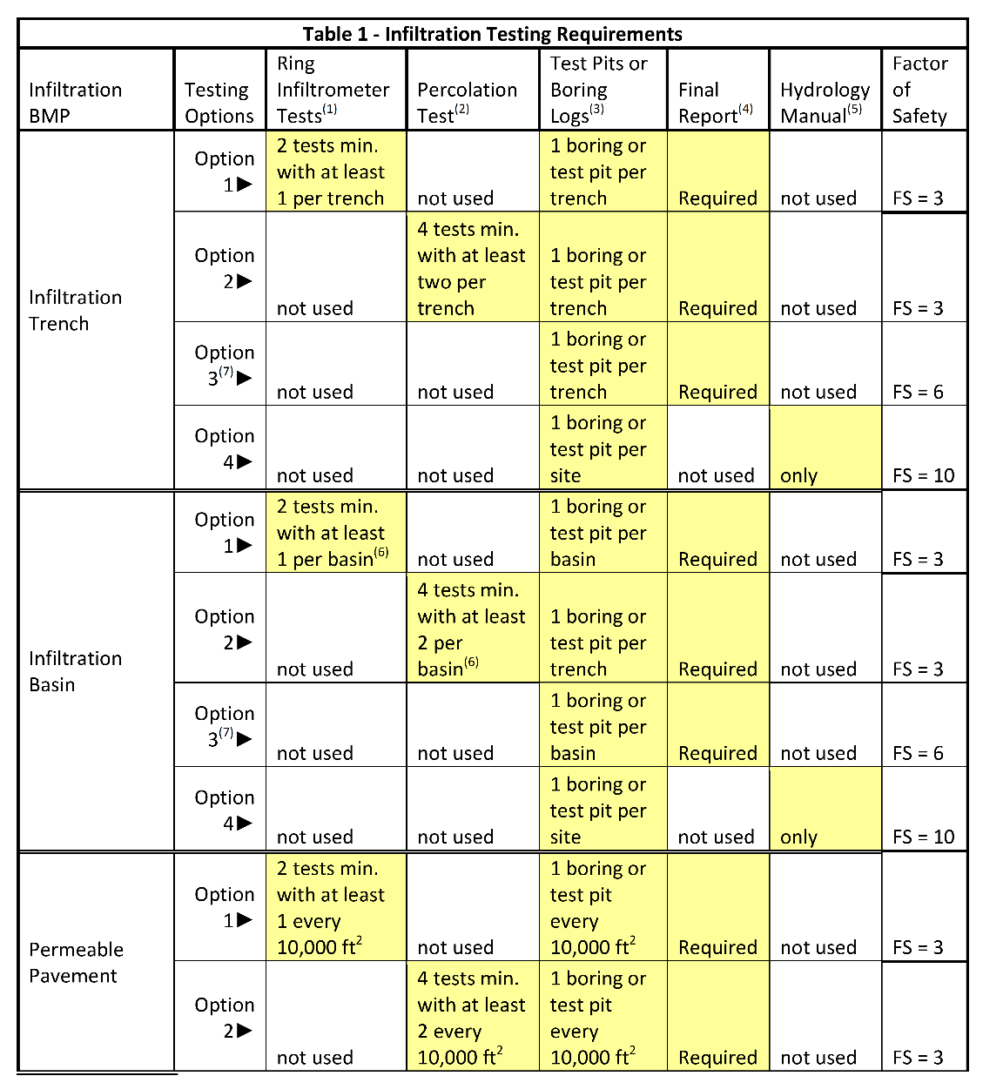
Preliminary WQMPs
Infiltration Testing
BMPs size increases up to 333% if test are not taken in the location of the BMP.

Slide 25
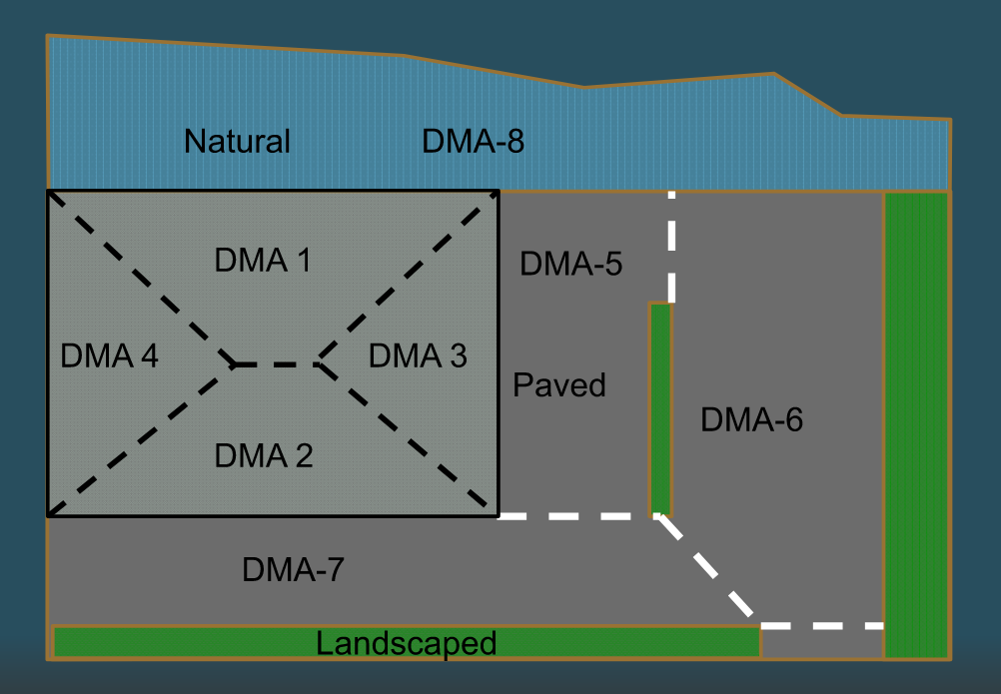
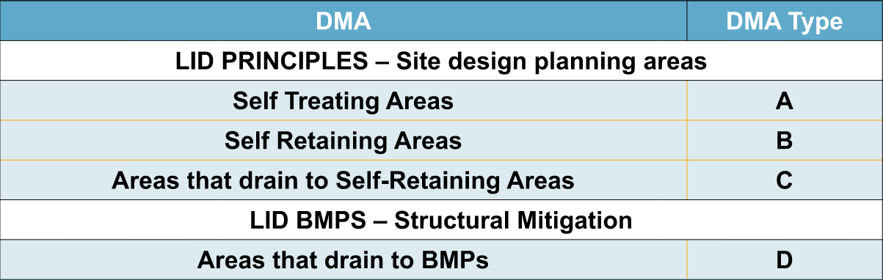
DMA TYPes for
Santa Ana & San Diego

Slide 26
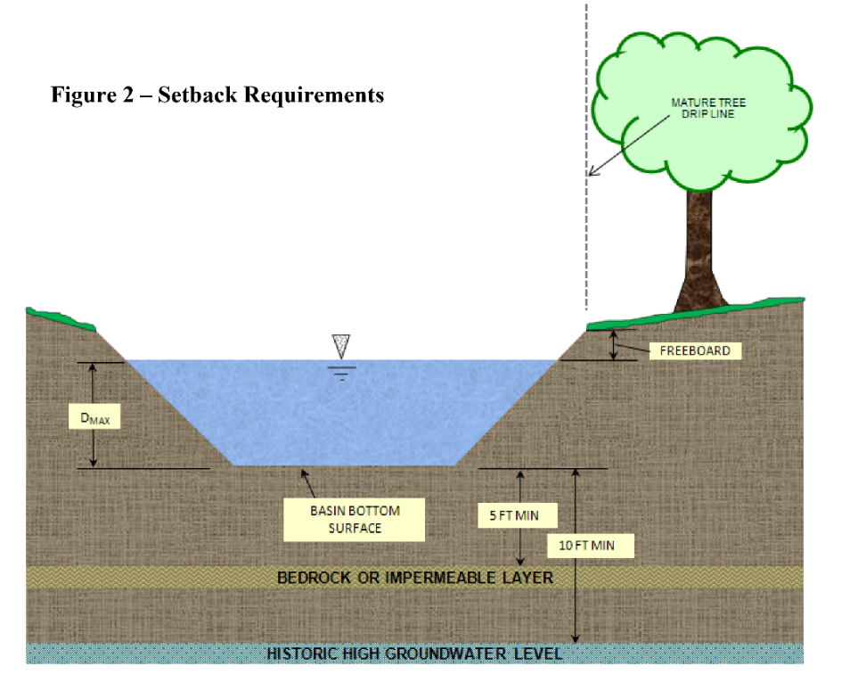
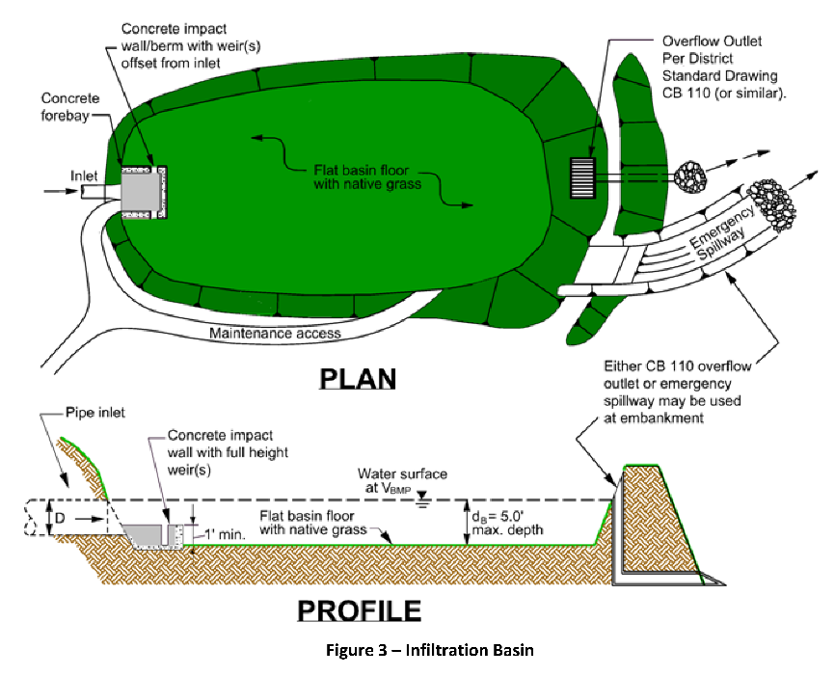
Preliminary WQMPs
Infiltration Basins
5’ of permeable soil underneath
Pretreatment required

Slide 27
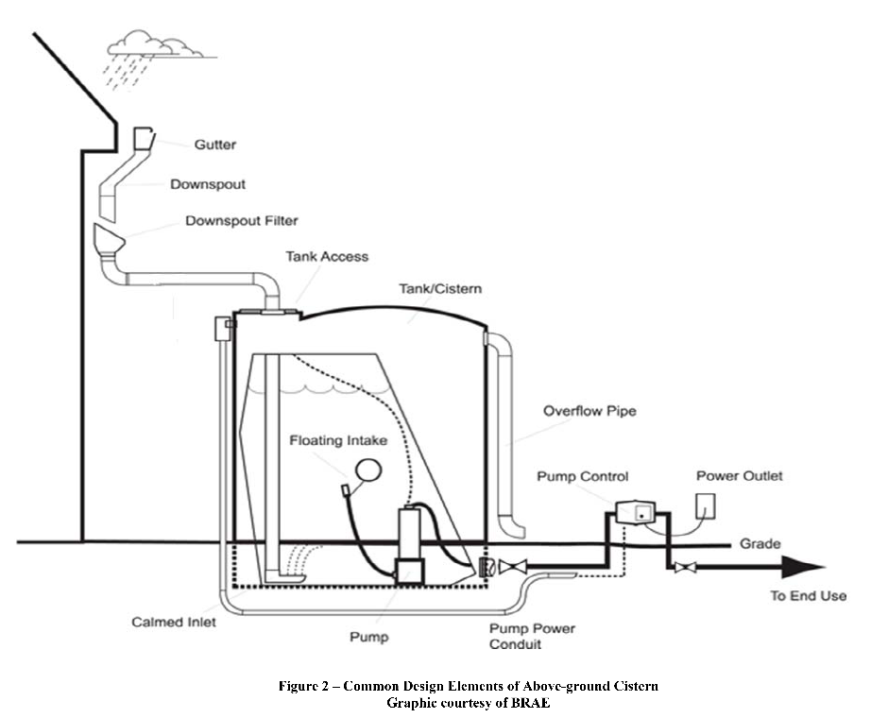
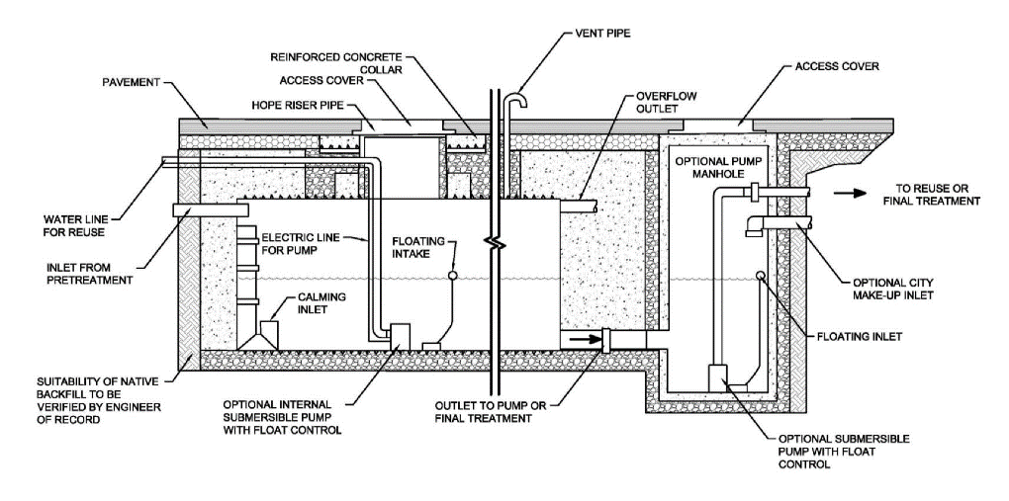
Preliminary WQMPs
Harvest and Reuse
Pretreatment is required

Slide 28
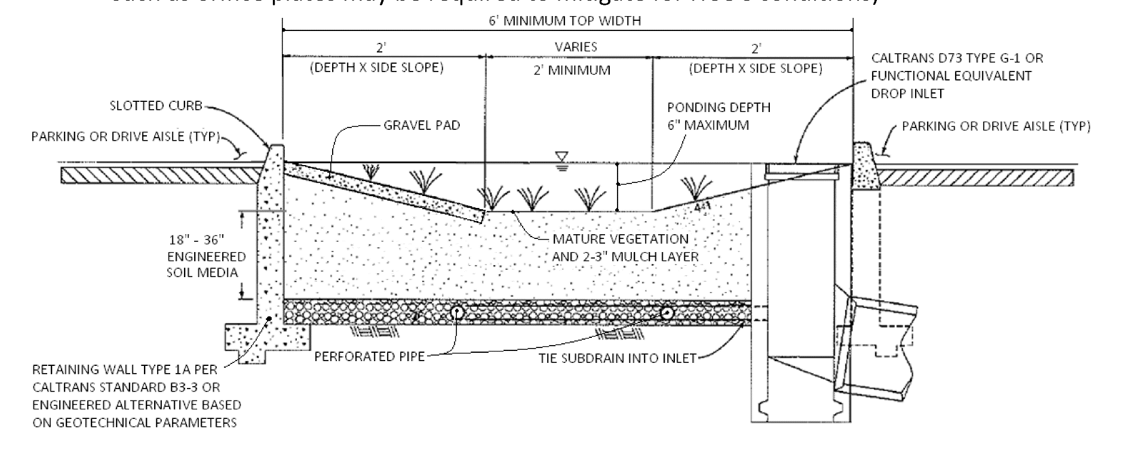
Preliminary WQMPs
BioRetention
Subdrain System

Slide 29
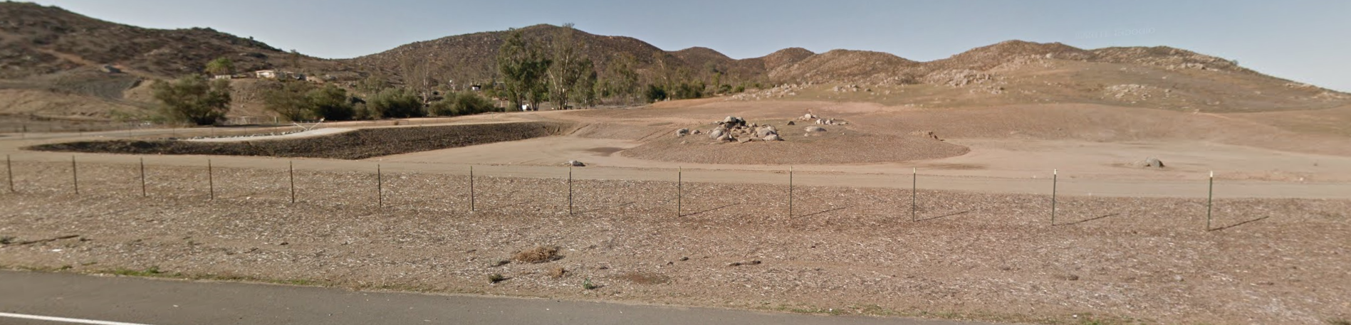
Preliminary WQMPs
BioTreatment
E.g. EDB’s
  Compacted Floor
  Treats thru settling

Slide 30
Preliminary WQMPs
Whitewater (BMP Type Selection)
(To the extent feasible) LID/Site Design BMPs used to satisfy the Treatment Control BMP requirement must:
Promote retention and/or feature a natural treatment mechanism. Examples include, but are not limited to: extended detention basins, retention basins, drywells, and naturally-lined swales and filter strips; and
Have medium or high effectiveness in reducing those Pollutants of Concern causing Receiving Water impairment.

Slide 31
Preliminary WQMPs
BMP Sizing

Slide 32
Preliminary WQMPs
Sizing BMPs
Quality | Quantity
VBMP – Volume for the BMP | HydroModification or HCOC’s (hydrologic conditions of concerns) | In addition the project must comply with Drainage Law (i.e. mitigate increased runoff)
Based on 85th percentile storm | Santa Ana: 2yr – 24hr
 | San Diego: Flowrate & Durations less than pre-dev. From 10% of 2yr to 10yr for entire rainfall record (continuous simulation)
 | Whitewater: Detention or Retention for the 100yr. for drainage law compliance.

Slide 33
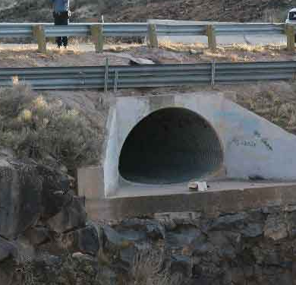
Preliminary WQMPs
What areas need to be treated with a WQMP?
You don’t need to treat areas that drain around the proposed BMPs.

Slide 34
Preliminary WQMPs
  So what do these sizing calculations look like?

Slide 35
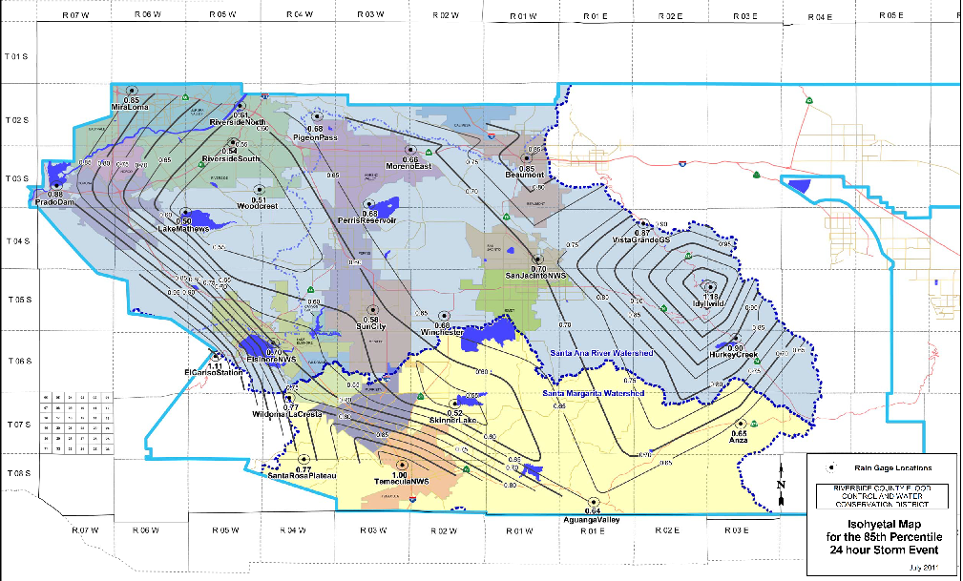
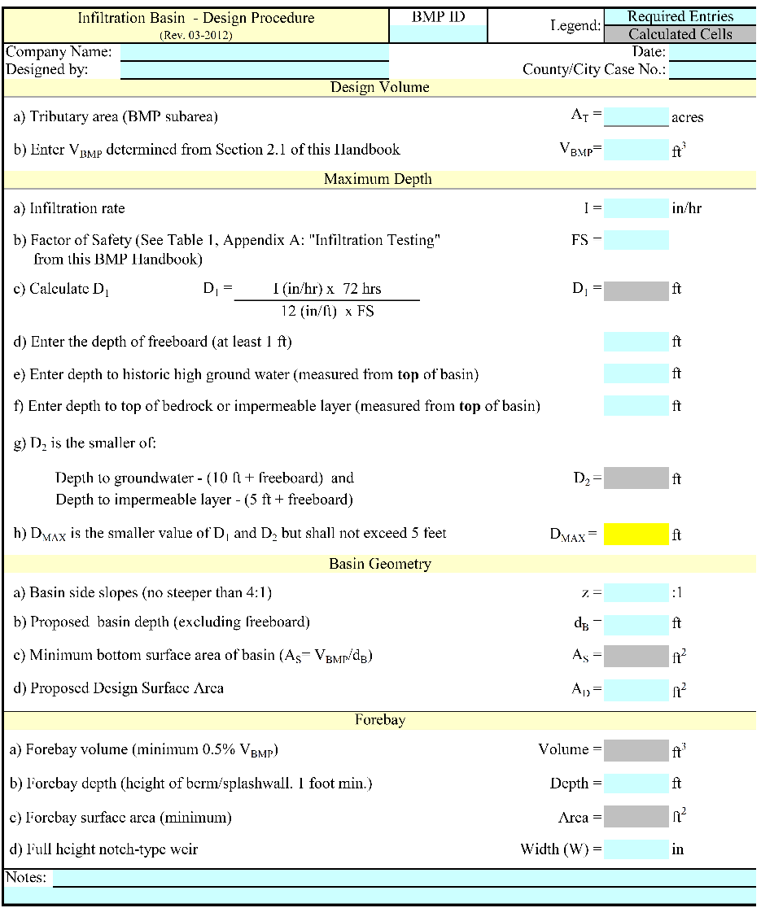
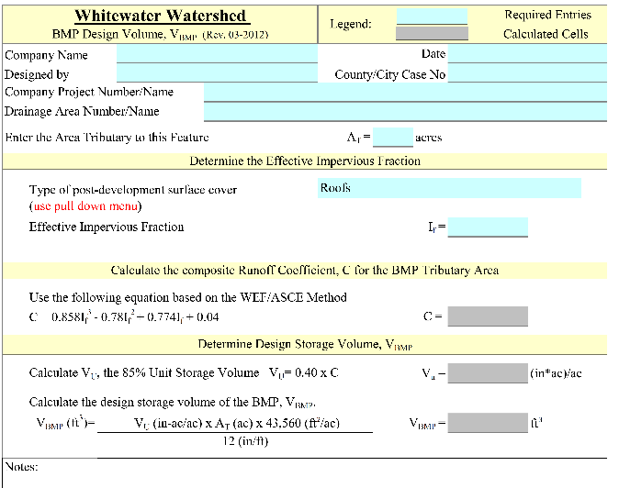
BMP Sizing
  Water Quality
Calculate VBMP
then size BMP

Slide 36

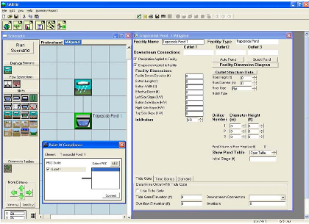
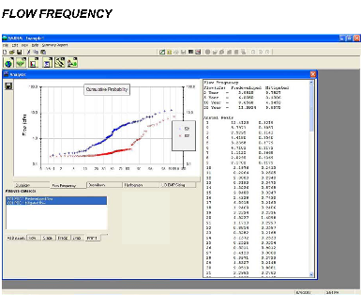
BMP Sizing
  Water Quantity – HCOC/Hydromodification
  Santa Ana Region WhiteWater Region Santa Margarita Region
CivilD with Basin Routing
CivilD or Hydrology Manual Shortcut for Retention
SMRHM by Clear Creek Solutions
County HydroMod Iterative Spreadsheet Model

Slide 37
BMP Sizing
  BMP Size is OFTEN Governed by
  HCOC/HydroMod
HCOC
HCOC
Size of BMP
Water Quality
Water Quality

Slide 38
Preliminary WQMPs
RECAP
The 3 key factors for P-WQMP’s are:
WQMP Applicability
BMP Type (Required Hierarchy)
BMP sizing
FEASIBILITY
Conservative Analysis can be used to show Feasibility

Slide 39
Final WQMPs

Slide 40
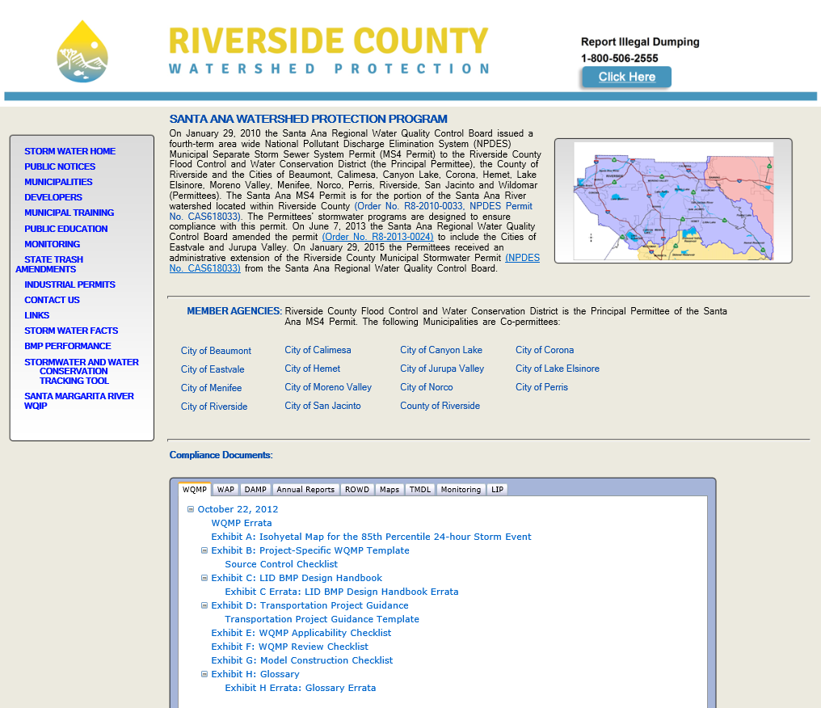
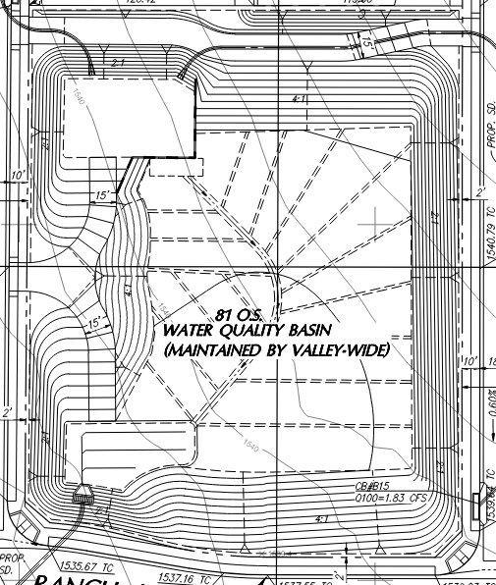
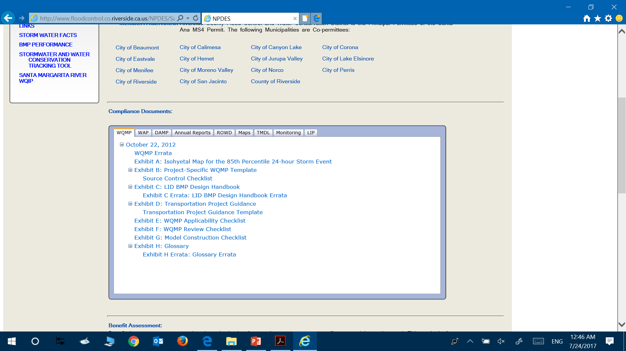
Final WQMPs
Complete the Template
                F-WQMP is substantially conforming with P-WQMP
                Consistent with Improvement Plans

Slide 41
MS4 Permit Negotiations

Slide 42
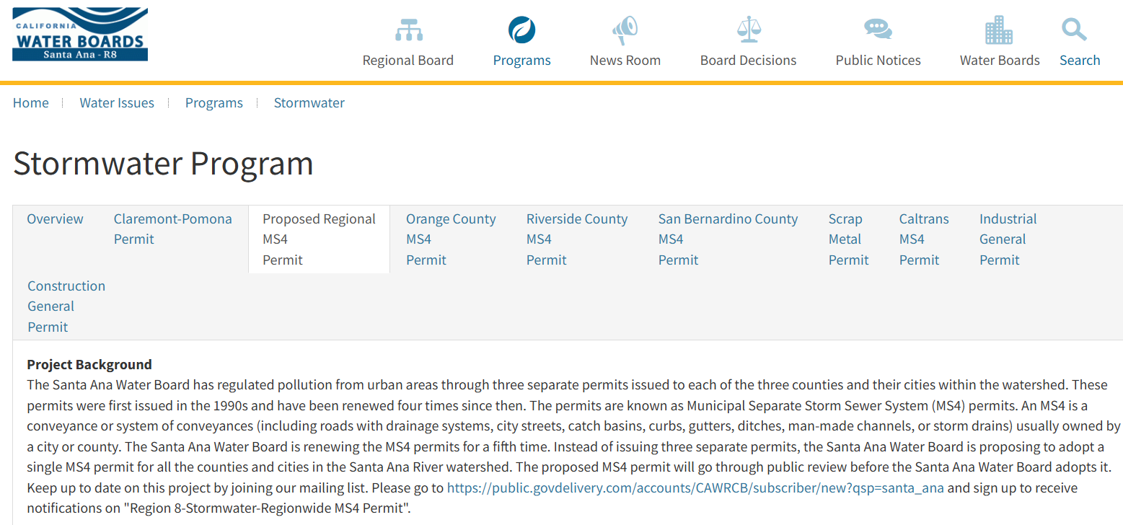
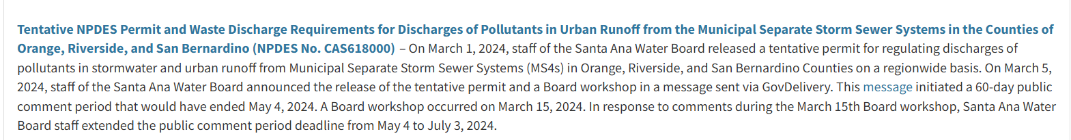
Released Draft
https://www.waterboards.ca.gov/santaana/water_issues/programs/stormwater/

Slide 43
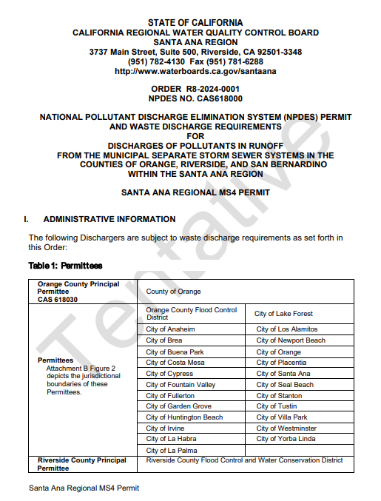
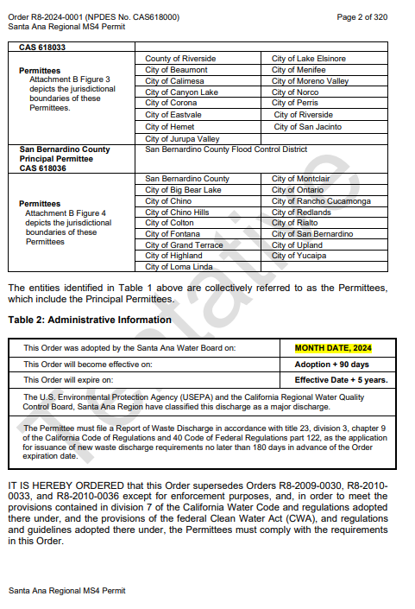
Released Draft

Slide 44
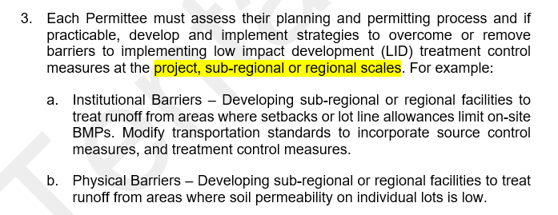
Released Draft
Some Institutional Barriers may include:
State Subdivision Map act 66462.5 may require waiving off-site improvements, including the BMPs are if they are “offsite”.
There are concerns with CEQA clearance. Private Development would need to expand their CEQA footprint to cover offsite improvements.
Maintenance Entities (CFD’s, CSA’s, LMD’s) would not be fully funded until all contributing projects are completed. BMPs without proper maintenance will fail.
However, a credit system may work on a project by project basis.

Slide 45
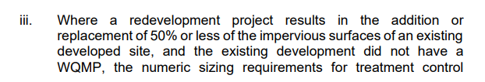
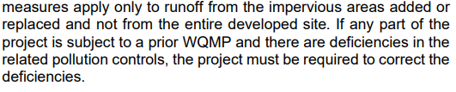
Released Draft
that pertain to the WQMP requirements at the time the WQMP was approved.
It could be interpreted that existing WQMPs would need to be upgraded to the latest WQMP requirements, which may not be feasible if there are R/W constraints. This could require digging out the BMP for infiltration testing and changing the size and shape of the BMP.

Slide 46
Released Draft
Disturbing more than 5,000 square feet of slope where the natural slope is 25% or more, or slope areas with known erosive soil conditions.
The original language triggered projects that may not have been intended to require WQMP. For example, if a Single family home project had steep slopes on the property, but was only developing on the existing flat areas this would trigger WQMP with the existing language.

Slide 47

Released Draft
The roads are typically lower than the proposed development, which would make many situations technically infeasible to drain the road runoff to the on-site BMPs. It would be within the maximum extent practicable to be able to handle the streets as part of private development with Green Streets treatment.

Slide 48
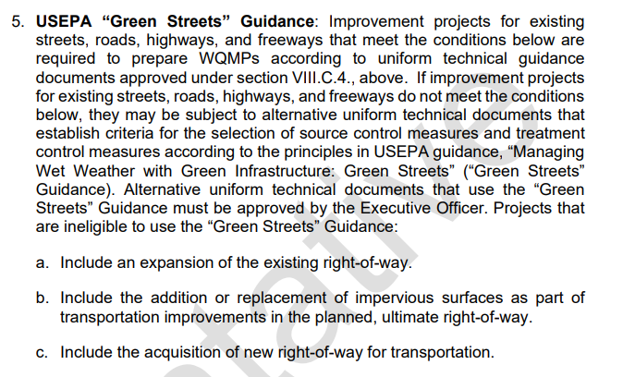
Released Draft
Additional right-of-way in of itself does not contribute toward increased potential for pollutant generation.
Replacement is generally for replacing failing asphalt for the benefit of the traveling public, or to address safety issues with design speeds. Replacement is not done without a reasonable purpose.
Why not allow Green Streets for projects that cannot physically drain on-site for treatment?

Slide 49
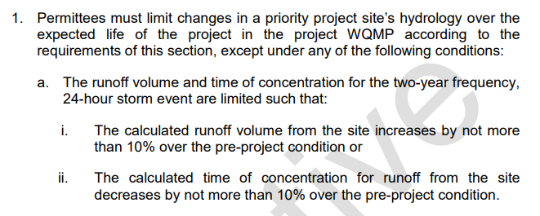
Released Draft
Volume and time of concentration cannot be technically mitigated for unless the site can fully infiltrate the difference between the pre- and post-development flows. This is not technically feasible.
Imagine your BMP that is 10% of your site, is required to infiltrate the difference between the pre- and post- development volume.

Slide 50
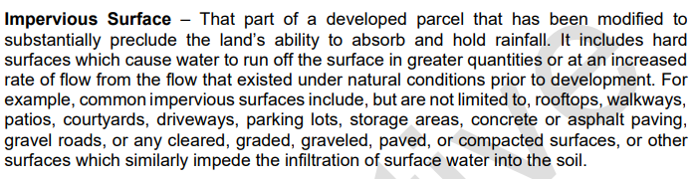
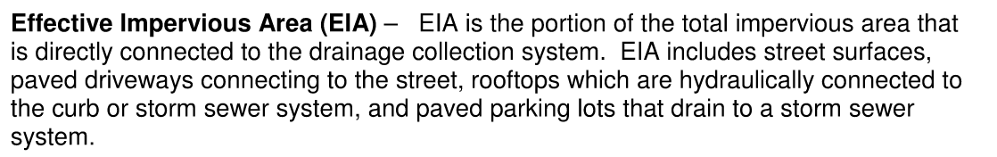
Released Draft
2010 Permit Language:

Slide 51
Questions
Santa Ana WQMP:
https://rcwatershed.org/watersheds/middle-santa-ana-river-watershed/
Santa Margarita WQMP:
https://rcwatershed.org/watersheds/santa-margarita-river-watershed/smrwma-clearinghouse
Whitewater WQMP:
https://rcwatershed.org/watersheds/whitewater-river-watershed/
County WQMP website:
https://trans.rctlma.org/wqmp-water-quality-management-plans
BMP Agreement and other useful forms & applications:
https://trans.rctlma.org/forms-applications
Would you like to see the Hydromod Spreadsheet?
Grading and WQMP Cert Forms:
https://building.rctlma.org/forms

